Slide 1
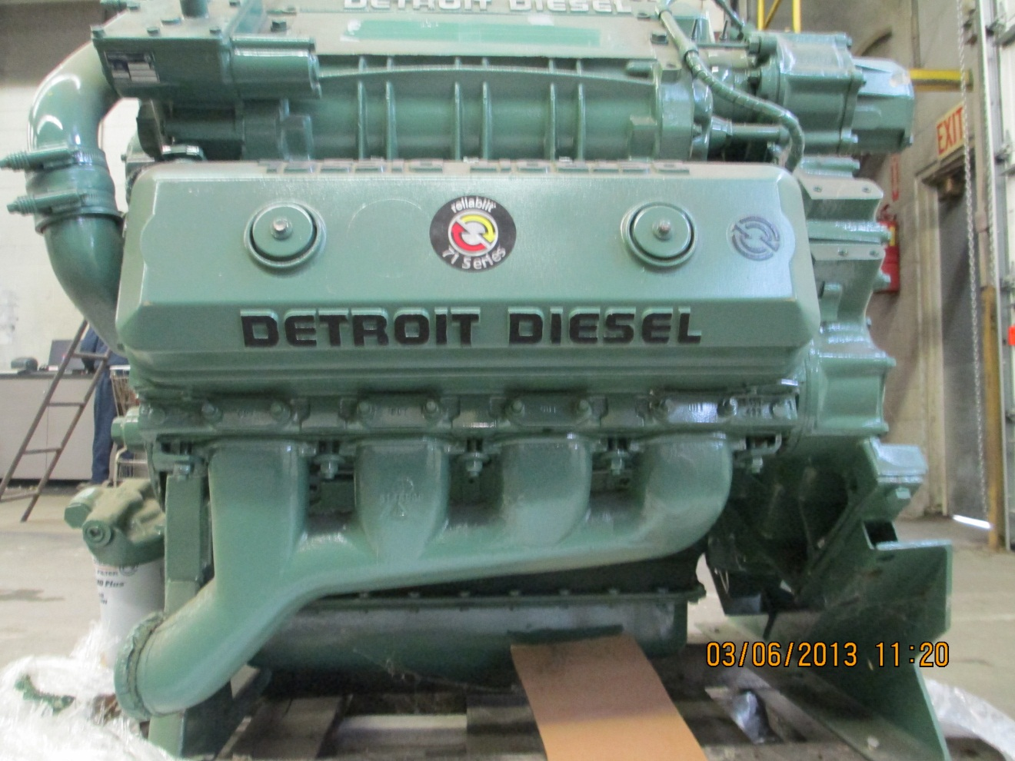
DETROIT 8V71 NATURALLY ASPIRATED
Reliabilt Engine, S/N 08FV004665, Model 7087-4020, spec # 104628, Never been in service $5,500 OUTRIGHT

